Slide 1
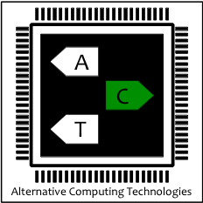
Reinforcement Learning and Adaptive Sampling for Optimized DNN Compilation
Byung Hoon Ahn, Prannoy Pilligundla, Hadi Esmaeilzadeh
Alternative Computing Technologies (ACT) Lab
University of California, San Diego

Slide 2

Neural network compilation
Deep learning compiler’s objective is to
Speed Up deep learning models’ inference, detection…

Slide 3
Neural network compilation
Code Template
Design Space
Dimension / Knob
Description
tile_f, tile_y, tile_x
Tiling and binding for # of filters, height,
and width of feature map
tile_rc, tile_ry, tile_rx
Tiling and binding for reduction axis such as
channels, height, and width of filters
auto_unroll_max_step
Threshold of # of steps in the loop to be
automatically unrolled during code generation
unroll_explicit
Explicit hint for code generation phase
to unroll the loop

Slide 4
Neural network compilation
Code Template
Design Space
Dimension / Knob
Description
tile_f, tile_y, tile_x
Tiling and binding for # of filters, height,
and width of feature map
tile_rc, tile_ry, tile_rx
Tiling and binding for reduction axis such as
channels, height, and width of filters
auto_unroll_max_step
Threshold of # of steps in the loop to be
automatically unrolled during code generation
Optimizing Compiler’s Objective is to
Find Optimal Configuration
unroll_explicit
Explicit hint for code generation phase
to unroll the loop

Slide 5
Prohibitive optimization time limits further innovation and diversity in neural networks
Takes Over 10 Hours to Optimize ResNet-18

Slide 6
Challenges
1
2
How to improve
efficacy of the search?
How to reduce costly
hardware measurements?

Slide 7
Challenges
1
2
How to improve
efficacy of the search?
How to reduce costly
hardware measurements?
We need to overcome two interrelated challenges

Slide 8
RELEASE
Reinforcement Learning Compiler with Adaptive Sampling for Efficiency
Reinforcement Learning improves Search Efficacy
Adaptive Sampling improves Sample Efficiency

Slide 9
Challenges
1
2
How to improve
efficacy of the search?
How to reduce costly
hardware measurements?
We need to overcome two interrelated challenges

Slide 10
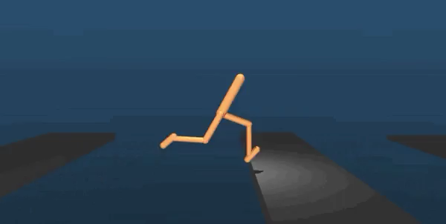
RL has been successful with autonomous decision making in complex settings
Apply Reinforcement Learning to Search Process

Slide 11
RL-based Search Agent
Start off with initial set of points (128) For each point…

Slide 12
RL-based Search Agent
2. Pass it through policy network for action (increment ↑,
stay -,
decrement ↓)

Slide 13
RL-based Search Agent
3. Use configuration updater to acquire new configuration

Slide 14
RL-based Search Agent
4. Repeat the search step 500 times = episode

Slide 15
RL-based Search Agent
5. Update agent using reward (estimated hardware measurement)

Slide 16
RL-based Search Agent
6. Repeat this episode for all 128 points
…

Slide 17
We have 128 x 500 = 64,000 samples
64,000 are too many to be measured on real hardware
1s x 64,000 = 18 hours

Slide 18
We have 128 x 500 = 64,000 samples
64,000 are too many to be measured on real hardware
1s x 64,000 = 18 hours
How to choose meaningful samples to measure on real hardware?

Slide 19
Challenges
1
2
How to improve
efficacy of the search?
How to reduce costly
hardware measurements?
We need to overcome two interrelated challenges

Slide 20
Analyzing the configuration sample distribution

Slide 21
Analyzing the configuration sample distribution
Reduce cluster to point that are each
representative of the cluster

Slide 22
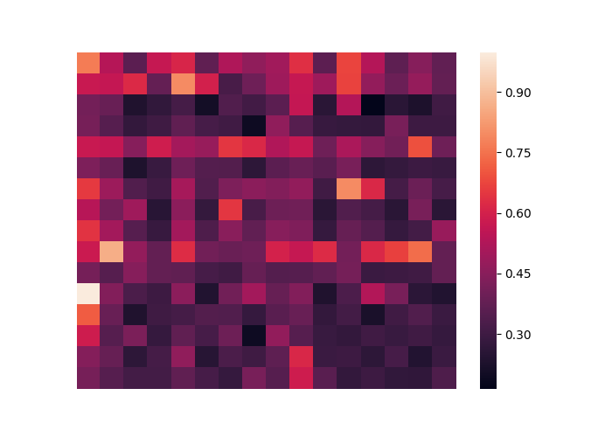
Wouldn’t that compromise performance?
Relatively
good region
Tile_y
TFLOP
Relatively
bad region
tile_x
Although the search space is unstructured
changes along the axis are gradual

Slide 23
How many clusters?
Less centroids = Faster optimization
More centroids = Better output code perf.
Iterate through different number of centroids and find knee of the loss curve
knee = pareto optimality

Slide 24
Adaptive sampling algorithm

Slide 25
Benchmarks for RELEASE
Evaluation
Name
Description
Layer Type
Dataset
No. of Tasks
AlexNet
Image Classification
Convolution
ImageNet
5
VGG-16
Image Classification
Convolution
9
ResNet-18
Image Classification
Convolution
12
Hardware
Name
Description
Titan Xp
Server-class GPU

Slide 26
RL-based Search Agent
Reinforcement Learning based search shows 2.88x improvement
in search steps over Simulated Annealing in AutoTVM

Slide 27
Adaptive Sampling Module
Adaptive Sampling shows 2.33x improvement for RL-based search in sample efficiency over Naïve sampling
Adaptive Sampling even shows 1.98x improvement
for Simulated Annealing in AutoTVM

Slide 28
Putting it all together
RELEASE achieves better performance
with less hardware measurements than AutoTVM

Slide 29
RELEASE
RELEASE shows 4.00x improvement in optimization time
with 5.6% improvement in output performance than AutoTVM

Slide 30
Conclusion
We formulating optimizing compilation of DNNs as a Reinforcement Learning problem in contrast to simulated annealing taking fewer steps to converge to better or same quality solution.
We devise an Adaptive Sampling algorithm that leverages clustering to focus measurements to representative samples, reducing number of measurements while keeping their relevance to search high.

